Slide 1
Sketch one

Slide 2
Project Goals
To map the direct movements of the dancer to angular strong visualizations and the indirect movements to circular, flowing, exploring, almost organic visualizations. We would also like to explore using direct movements to minimize the rendering window to create a experience of inflexibility. Conversely, indirect and flowing movements could expand the rendering window.
The dancer will be improvising based on the tone and mood the group works to create. If the group chooses a more fierce or angry route, the dancer will choose to focus more on direct, strong movements like punching and wringing; whereas if the group chooses to go for something more calm and natural, the dancer will favor more flowing, freer movements. The dance will also incorporate a contrast of indirect versus direct movement.

Slide 3
Inspiration

Slide 4
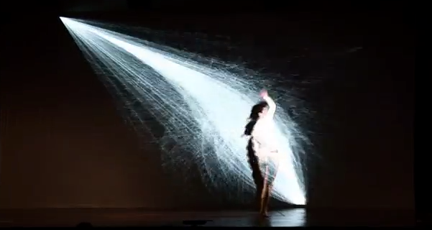
Inspiration
http://youtu.be/V2ADOQCspSI

Slide 5
Mood Research

Slide 6
Indirect Visualization
Free-flowing organic visualizations respond to indirect movements.

Slide 7
Indirect Visualization

Slide 8
inDirect Visualization
Fire-Based

Slide 9
Direct Visualization

Slide 10
Direct Visualization

Slide 11
Combination

Slide 12
Concept Art

Slide 13
Concepts
Direct Movements

Slide 14
Concepts
Direct Movements

Slide 15
Concepts
Direct Movements

Slide 16
Concepts
Indirect Concept

Slide 17
Concepts
Indirect Concept

Slide 18
Concepts
Indirect Movement

Slide 19
Technology

Slide 20
Technology
Microsoft Kinect for Recognition
Max for Audio Manipulation
Processing for Visualization
Mac Mini
Projector

Slide 21
Technology

Slide 22
Prototypes

Slide 23
Prototype
The intuition behind the metric is to measure the predictability of the path. For each point, we try to predict the next 5 steps by assuming the actual path will continue in the same linear predicted path. The screenshots show various paths and a scale from 0 to 100 of in/directness.

Slide 24
Prototype
One can imagine using a Kinect or Wiimote to generate this path. Once that is accomplished, interactive visualizations and sonifications can be mapped to this metric.

Slide 25
Prototype

Slide 26
Stage Setup

Slide 27
Stage setup

