Slide 1
CSCE643: Computer Vision
Mean-Shift Object Tracking
Jinxiang Chai
Many slides from Yaron Ukrainitz & Bernard Sarel & Robert Collins

Slide 2
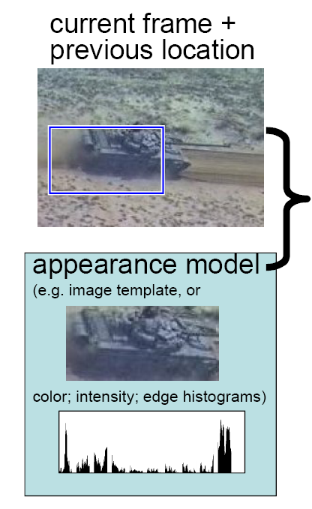
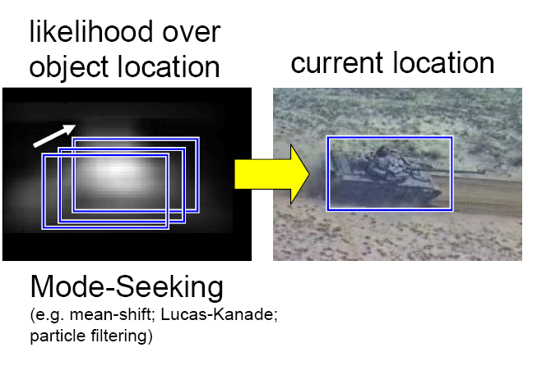
Appearance-based Tracking
Slide from Collins

Slide 3
Review:
Lucas-Kanade Tracking/Registration
Key Idea #1: Formulate the tracking/registration as a nonlinear least square minimization problem

Slide 4
Review:
Lucas-Kanade Tracking/Registration
Key Idea #2: Solve the problem with Gauss-Newton optimization techniques

Slide 5
Review:
Gauss-Newton Optimization
Rearrange

Slide 6
Review:
Gauss-Newton Optimization
Rearrange

Slide 7
Review:
Gauss-Newton Optimization
Rearrange
A
b

Slide 8
Review:
Gauss-Newton Optimization
Rearrange
A
b
(A^{T}A)⁻¹
A^{T}b

Slide 9
Lucas-Kanade Registration
Initialize p=p₀:
Iterate:
1. Warp I with w(x;p) to compute I(w(x;p))

Slide 10
Lucas-Kanade Registration
Initialize p=p₀:
Iterate:
1. Warp I with w(x;p) to compute I(w(x;p))
2. Compute the error image

Slide 11
Lucas-Kanade Registration
Initialize p=p₀:
Iterate:
1. Warp I with w(x;p) to compute I(w(x;p))
2. Compute the error image
3. Warp the gradient with w(x;p)

Slide 12
Lucas-Kanade Registration
Initialize p=p₀:
Iterate:
1. Warp I with w(x;p) to compute I(w(x;p))
2. Compute the error image
3. Warp the gradient with w(x;p)
4. Evaluate the Jacobian at (x;p)

Slide 13
Lucas-Kanade Registration
Initialize p=p₀:
Iterate:
1. Warp I with w(x;p) to compute I(w(x;p))
2. Compute the error image
3. Warp the gradient with w(x;p)
4. Evaluate the Jacobian at (x;p)
5. Compute the using linear system solvers

Slide 14
Lucas-Kanade Registration
Initialize p=p₀:
Iterate:
1. Warp I with w(x;p) to compute I(w(x;p))
2. Compute the error image
3. Warp the gradient with w(x;p)
4. Evaluate the Jacobian at (x;p)
5. Compute the using linear system solvers
6. Update the parameters

Slide 15
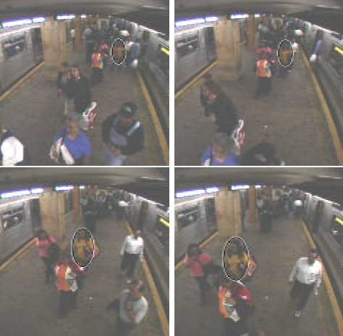
Object Tracking
Can we apply Lucas-Kanade techniques to non-rigid objects (e.g., a walking person)?

Slide 16
Motivation of Mean Shift Tracking
To track non-rigid objects (e.g., a walking person), it is hard to specify an explicit 2D parametric motion model.
Appearances of non-rigid objects can sometimes be modeled with color distributions

Slide 17
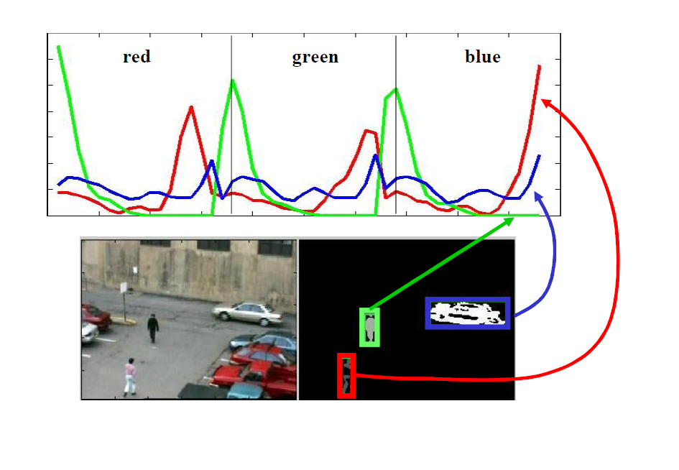
Mean-Shift Tracking
The mean-shift algorithm is an efficient approach to tracking objects whose appearance is defined by histograms.
- not limited to only color, however.
- Could also use edge orientation, texture motion
Slide from Robert Collins

Slide 18
Mean Shift Tracking: Demos

Slide 19
Mean Shift
Mean Shift [Che98, FH75, Sil86]
- An algorithm that iteratively shifts a data point to the average of data points in its neighborhood.
- Similar to clustering.
- Useful for clustering, mode seeking, probability density estimation, tracking, etc.

Slide 20
Mean Shift Reference
Y. Cheng. Mean shift, mode seeking, and clustering. IEEE Trans. on Pattern Analysis and Machine Intelligence, 17(8):790–799, 1998.
K. Fukunaga and L. D. Hostetler. The estimation of the gradient of a density function, with applications in pattern recognition. IEEE Trans. on Information Theory, 21:32–40, 1975.
B. W. Silverman. Density Estimation for Statistics and Data Analysis. Chapman and Hall, 1986.

Slide 21
Mean Shift Theory

Slide 22
Intuitive Description
Region of
interest
Center of
mass
Mean Shift
vector
Objective : Find the densest region
Distribution of identical billiard balls

Slide 23
Intuitive Description
Region of
interest
Center of
mass
Mean Shift
vector
Objective : Find the densest region
Distribution of identical billiard balls

Slide 24
Intuitive Description
Region of
interest
Center of
mass
Mean Shift
vector
Objective : Find the densest region
Distribution of identical billiard balls

Slide 25
Intuitive Description
Region of
interest
Center of
mass
Mean Shift
vector
Objective : Find the densest region
Distribution of identical billiard balls

Slide 26
Intuitive Description
Region of
interest
Center of
mass
Mean Shift
vector
Objective : Find the densest region
Distribution of identical billiard balls

Slide 27
Intuitive Description
Region of
interest
Center of
mass
Mean Shift
vector
Objective : Find the densest region
Distribution of identical billiard balls

Slide 28
Intuitive Description
Region of
interest
Center of
mass
Objective : Find the densest region
Distribution of identical billiard balls

Slide 29
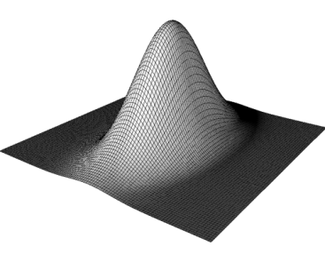
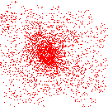
What is Mean Shift ?
A tool for:
Finding modes in a set of data samples, manifesting an
underlying probability density function (PDF) in R^{N}
PDF in feature space
Color space
Scale space
Actually any feature space you can conceive
…
Non-parametric
Density Estimation
Discrete PDF Representation
Data
Non-parametric
Density GRADIENT Estimation
(Mean Shift)
PDF Analysis

Slide 30
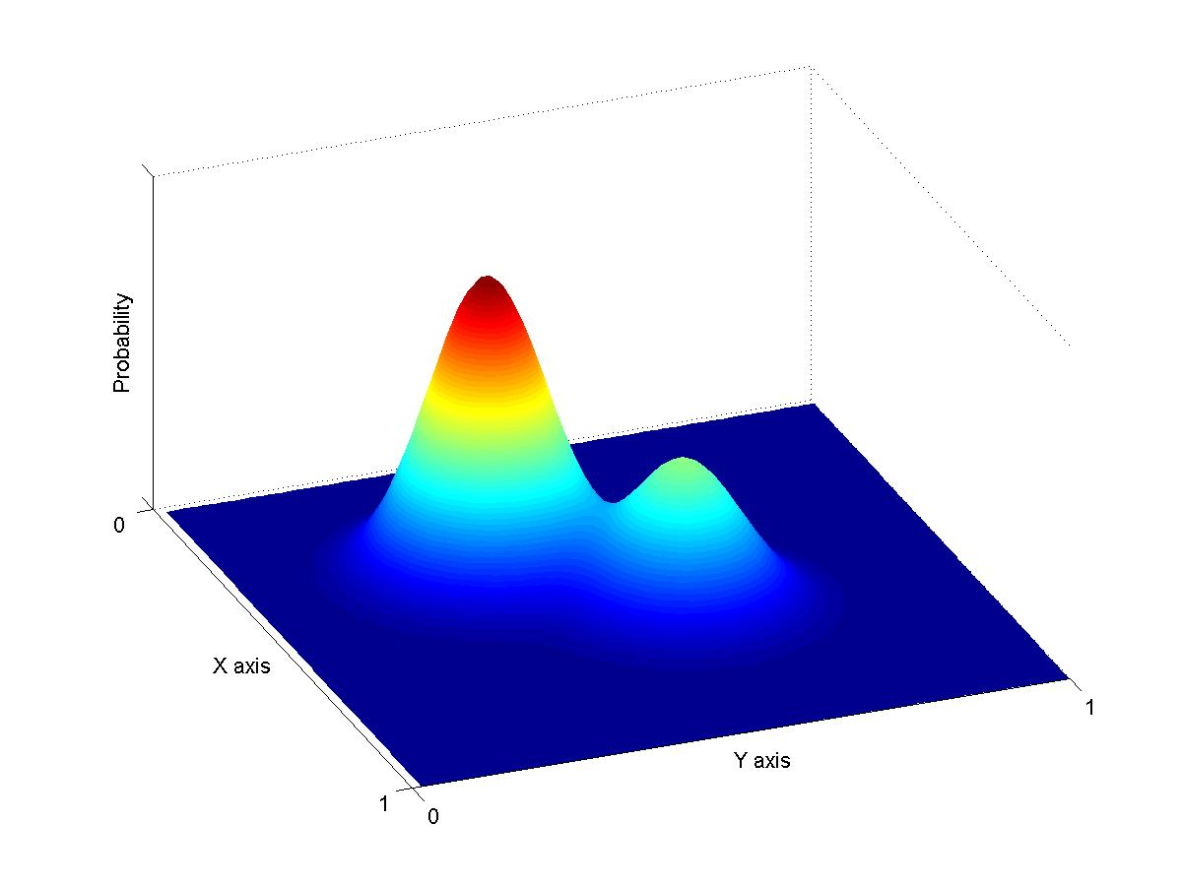
Non-Parametric Density Estimation
Assumption : The data points are sampled from an underlying PDF
Data point density
implies PDF value !
Assumed Underlying PDF
Real Data Samples

Slide 31
Non-Parametric Density Estimation
Assumed Underlying PDF
Real Data Samples

Slide 32
Non-Parametric Density Estimation
?
Assumed Underlying PDF
Real Data Samples

Slide 33
Parametric Density Estimation
Assumption : The data points are sampled from an underlying PDF
Estimate
Assumed Underlying PDF
Real Data Samples

Slide 34
Kernel Density Estimation
Parzen Windows - General Framework
A function of some finite number of data points
x₁…x_{n}
Kernel Properties:
Normalized
Symmetric
Exponential weight
decay
???
Data

Slide 35
Kernel Density Estimation
Parzen Windows - Function Forms
A function of some finite number of data points
x₁…x_{n}
Data
In practice one uses the forms:
or
Same function on each dimension
Function of vector length only

Slide 36
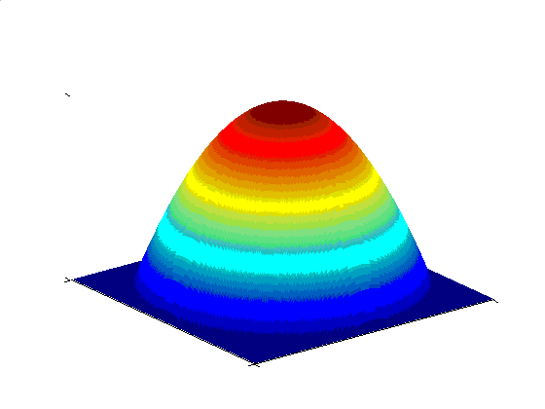
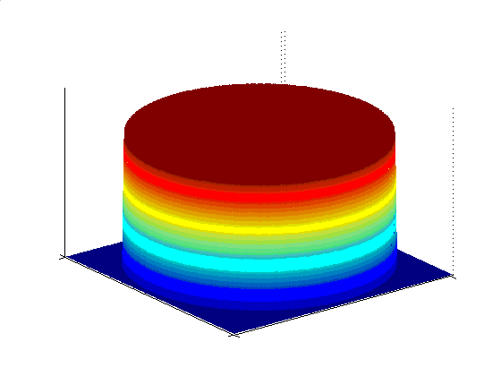
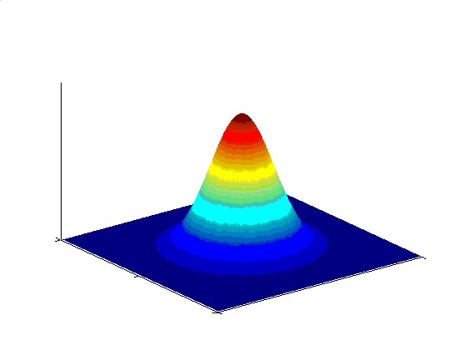
Kernel Density Estimation
Various Kernels
A function of some finite number of data points
x₁…x_{n}
Examples:
Epanechnikov Kernel
Uniform Kernel
Normal Kernel
Data

Slide 37
Kernel Density Estimation
Gradient
Give up estimating the PDF !
Estimate ONLY the gradient
Using the
Kernel form:
We get :
Size of window

Slide 38
Kernel Density Estimation
Computing The Mean Shift
Gradient

Slide 39
Computing The Mean Shift
Yet another Kernel
density estimation !
Simple Mean Shift procedure:
Compute mean shift vector
Translate the Kernel window by m(x)

Slide 40
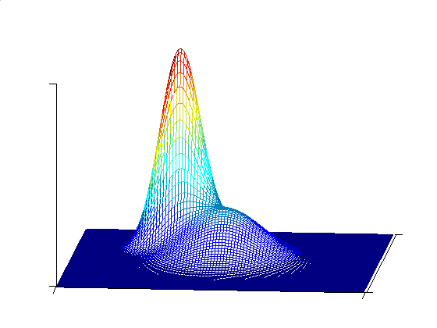
Mean Shift Mode Detection
What happens if we
reach a saddle point
?
Perturb the mode position
and check if we return back
Updated Mean Shift Procedure:
Find all modes using the Simple Mean Shift Procedure
Prune modes by perturbing them (find saddle points and plateaus)
Prune nearby – take highest mode in the window

Slide 41
Mean Shift Strengths & Weaknesses
Strengths :
Application independent tool
Suitable for real data analysis
Does not assume any prior shape
(e.g. elliptical) on data clusters
Can handle arbitrary feature
spaces
Only ONE parameter to choose
h (window size) has a physical
meaning, unlike K-Means
Weaknesses :
The window size (bandwidth
selection) is not trivial
Inappropriate window size can
cause modes to be merged,
or generate additional “shallow”
modes ➔ Use adaptive window
size

Slide 42
Mean Shift Applications

Slide 43
Mean Shift Object Tracking
D. Comaniciu, V. Ramesh, and P. Meer. Real-time tracking of non-rigid objects using mean shift. In IEEE Proc. on Computer Vision and Pattern Recognition, pages 673–678, 2000. (Best paper award)
Journal version: Kernel-Based Object Tracking, PAMI, 2003.

Slide 44
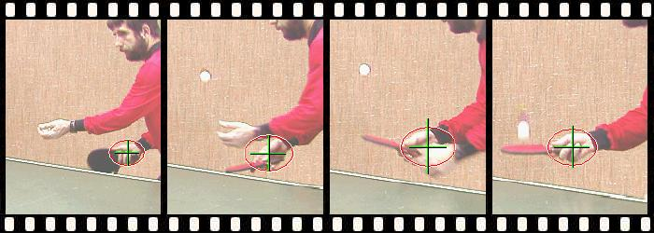
Non-Rigid Object Tracking
…
…

Slide 45
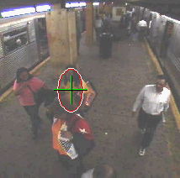
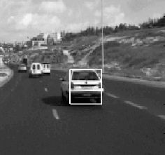
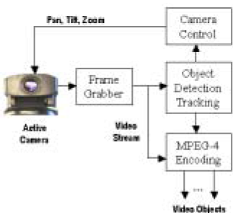
Non-Rigid Object Tracking
Real-Time
Object-Based Video Compression
Surveillance
Driver Assistance

Slide 46
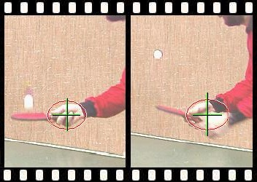
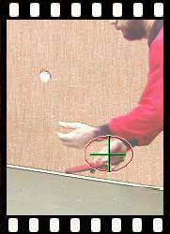
Mean-Shift Object Tracking
General Framework: Target Representation
Choose a reference model in the current frame
Choose a feature space
Represent the model in the chosen feature space
…
Current frame
…

Slide 47
Mean-Shift Object Tracking
General Framework: Target Localization
Start from the position of the model in the current frame
Search in the model’s neighborhood in next frame
Find best candidate by maximizing a similarity func.
Repeat the same process in the next pair of frames
Model
Candidate
…
Current frame
…

Slide 48
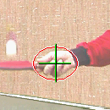
Mean-Shift Object Tracking
Target Representation
Choose a reference target model
Choose a feature space
Represent the model by its PDF in the feature space
Quantized Color Space
Kernel Based Object Tracking, by Comaniniu, Ramesh, Meer

Slide 49
Mean-Shift Object Tracking
PDF Representation
Target Model
(centered at 0)
Target Candidate
(centered at y)
Similarity
Function:

Slide 50
Mean-Shift Object Tracking
Smoothness of Similarity Function
Similarity Function:
Target is represented by color info only
Spatial info is lost
Large similarity variations for adjacent locations
Problem:
f is not smooth
Gradient-based optimizations are not robust
Mask the target with an isotropic kernel in the spatial domain
f(y) becomes smooth in y
Solution:

Slide 51
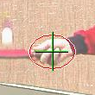
Mean-Shift Object Tracking
Finding the PDF of the target model
model
candidate
Target pixel locations
0
y
A differentiable, isotropic, convex, monotonically decreasing kernel
  Peripheral pixels are affected by occlusion and background interference
The color bin index (1..m) of pixel x
Probability of feature u in model
Probability of feature u in candidate
Normalization factor
Pixel weight
Normalization factor
Pixel weight

Slide 52
Mean-Shift Object Tracking
Similarity Function
Target model:
Target candidate:
Similarity function:
The Bhattacharyya Coefficient
1
1

Slide 53
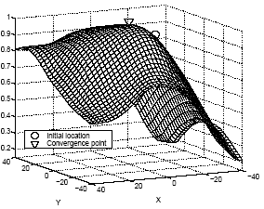
Mean-Shift Object Tracking
Target Localization Algorithm
Start from the position of the model in the current frame
Search in the model’s neighborhood in next frame
Find best candidate by maximizing a similarity func.

Slide 54
Mean-Shift Object Tracking
Function Optimization
Or

Slide 55
Mean-Shift Object Tracking
Function Optimization
Or
This is similar to Lucas Kanade registration!
- we can use gradient based optimization techniques to solve the problem.

Slide 56
Mean-Shift Object Tracking
Function Optimization
Or
Mean Shift provides an efficient way to optimize the function!

Slide 57
Mean-Shift Object Tracking
Approximating the Similarity Function
Model location:
Candidate location:
Linear approx.
(around y₀)
Independent of y
Density estimate!
(as a function of y)

Slide 58
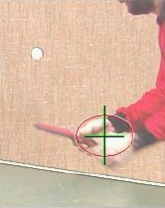
Mean-Shift Object Tracking
Maximizing the Similarity Function
The mode of
= sought maximum
Important Assumption:
The target representation provides sufficient discrimination
One mode in the searched neighborhood

Slide 59
Mean-Shift Object Tracking
Applying Mean-Shift
The mode of
= sought maximum
Original Mean-Shift:
Find mode of
using
Extended Mean-Shift:
Find mode of
using

Slide 60
Mean-Shift Object Tracking
About Kernels and Profiles
A special class of radially symmetric kernels:
The profile of kernel K
Extended Mean-Shift:
Find mode of
using

Slide 61
Mean-Shift Object Tracking
Choosing the Kernel
A special class of radially symmetric kernels:
Epanechnikov kernel:
Uniform kernel:
Extended Mean-Shift:

Slide 62
Mean-Shift Object Tracking
Adaptive Scale
Problem:
The scale of the target changes in time
The scale (h) of the kernel must be adapted
Solution:
Run localization 3 times with different h
Choose h that achieves maximum similarity

Slide 63
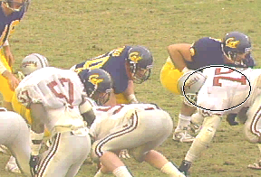
Mean-Shift Object Tracking
Results
Feature space: 16×16×16 quantized RGB
Target: manually selected on 1st frame
Average mean-shift iterations: 4

Slide 64
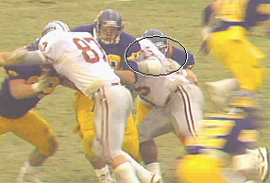
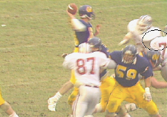
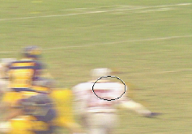
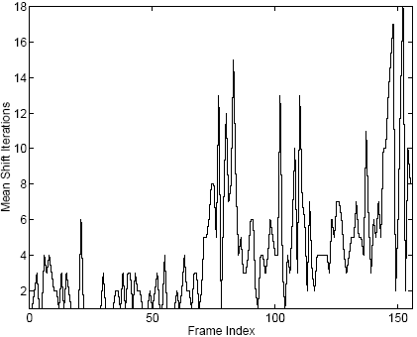
Mean-Shift Object Tracking
Results
Partial occlusion
Distraction
Motion blur

Slide 65
Mean-Shift Object Tracking
Results

Slide 66
Mean-Shift Object Tracking
Summary

Slide 67
Mean-Shift Object Tracking
Summary
Key idea #1: Formulate the tracking problem as nonlinear optimization by maximizing appearance/histogram consistency between target and template.

Slide 68
Mean-Shift Object Tracking
Summary
Key idea #2: Solving the optimization problem with mean-shift techniques

Slide 69
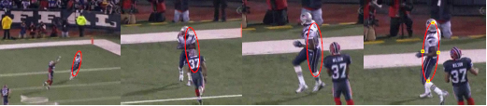
Mean-Shift Object Tracking
Discussion
How to deal with scaling and rotation?

