Slide 1
CSCE643: Computer Vision
Bayesian Tracking & Particle Filtering
Jinxiang Chai
Some slides from Stephen Roth

Slide 2
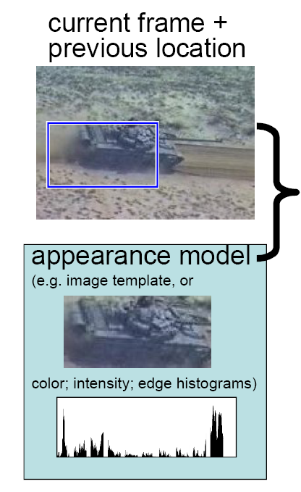
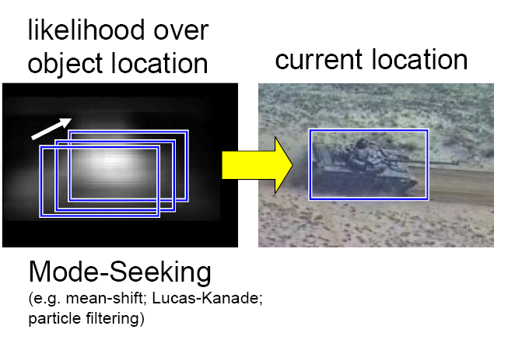
Appearance-based Tracking

Slide 3
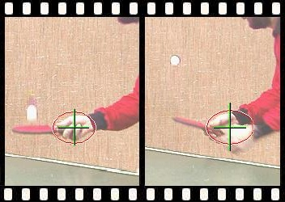
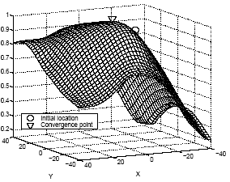
Review: Mean-Shift Tracking
Key idea #1: Formulate the tracking problem as nonlinear optimization by maximizing color histogram consistency between target and template.

Slide 4
Review: Mean-Shift Tracking
Key idea #2: Solving the optimization problem with mean-shift techniques

Slide 5
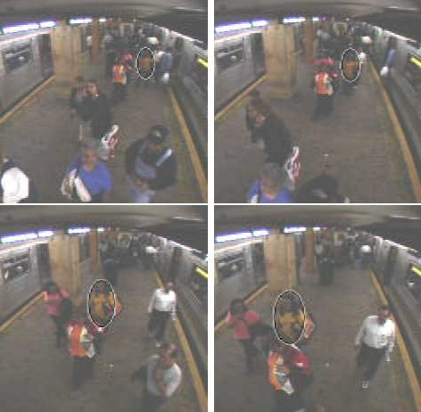
Review: Mean-Shift Tracking

Slide 6
Lucas-Kanade Registration & Mean-Shift Tracking
Key Idea #1: Formulate the tracking/registration as a function optimization problem
Lucas-Kanade registration
Mean Shift Tracking

Slide 7
Lucas-Kanade Registration & Mean-Shift Tracking
Key Idea #2: Iteratively solve the optimization problem with gradient-based optimization techniques
Linear approx.
(around y₀)
A
b
Independent of y
Density estimate!
(as a function of y)
(A^{T}A)⁻¹
A^{T}b
Gauss-Newton
Mean Shift

Slide 8
Optimization-based Tracking
Pros:
+ computationally efficient
+ sub-pixel accuracy
+ flexible for tracking a wide variety of objects (optical flow, parametric motion models, 2D color histograms, 3D objects)

Slide 9
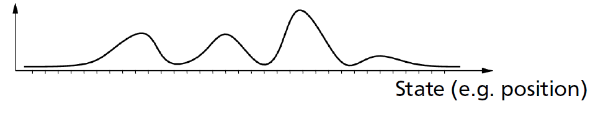
Optimization-based Tracking
Cons:
- prone to local minima due to local optimization techniques. This could be improved by global optimization techniques such as Particle swamp and Interacting Simulated Annealing
- fail to model multi-modal tracking results due to tracking ambiguities (e.g., occlusion, illumination changes)

Slide 10
Optimization-based Tracking
Solution: Bayesian Tracking & Particle Filter
Cons:
- prone to local minima due to local optimization techniques. This could be improved by global optimization techniques such as Particle swamp and Interacting Simulated Annealing
- fail to model multi-modal tracking results due to tracking ambiguities (e.g., occlusion, illumination changes)

Slide 11
Particle Filtering
Many different names
  Sequential Monte Carlo filters
  Bootstrap filters
  Condensation Algorithm

Slide 12
Bayesian Rules
Many computer vision problems can be formulated a posterior estimation problem
Observed measurements
Hidden states

Slide 13
Bayesian Rules
Many computer vision problems can be formulated a posterior estimation problem
Posterior: This is what you want. Knowing
p(X|Z) will tell us what is the
most likely state X.

Slide 14
Bayesian Rules
Likelihood term: This is what you can
evaluate
Posterior: This is what you want. Knowing
p(X|Z) will tell us what is the
most likely state X.

Slide 15
Bayesian Rules
Likelihood term: This is what you can
evaluate
Prior: This is what you may
know a priori, or what
you can predict
Posterior: This is what you want. Knowing
p(X|Z) will tell us what is the
most likely state X.

Slide 16
Bayesian Rules
Likelihood term: This is what you can
evaluate
Prior: This is what you may
know a priori, or what
you can predict
Posterior: This is what you want. Knowing
p(X|Z) will tell us what is the
most likely state X.
Evidence: This is a constant for observed measurements such as images

Slide 17
Bayesian Tracking
Problem statement: estimate the most likely state xk given the observations thus far Zk={z1,z2,…,zk}
Hidden state
x1
……
xk-2
xk-1
xk
Observed measurements
z1
……
zk-2
zk-1
zk

Slide 18
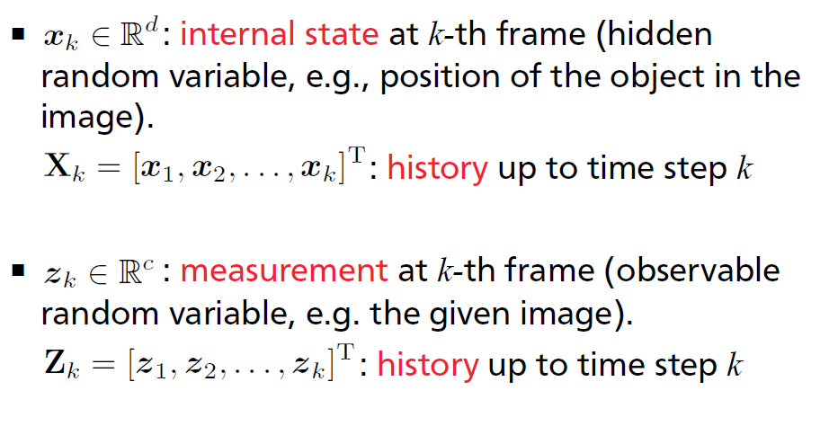
Notations

Slide 19
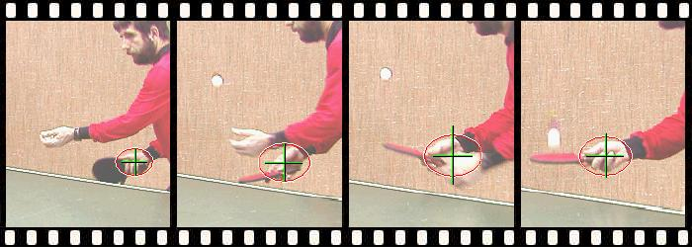
Examples
2D region tracking
xk:2D location and scale of interesting regions
zk: color histograms of the region

Slide 20
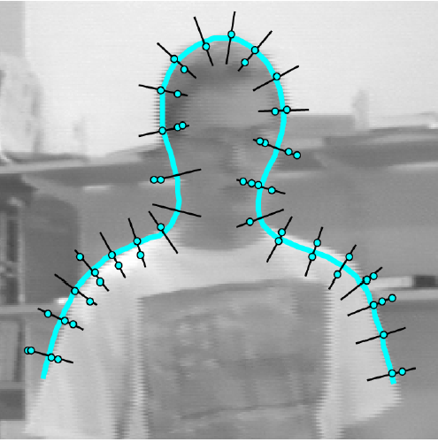

Examples
2D Contour tracking
xk: control points of spline-based contour representation
zk: edge strength perpendicular to contour

Slide 21
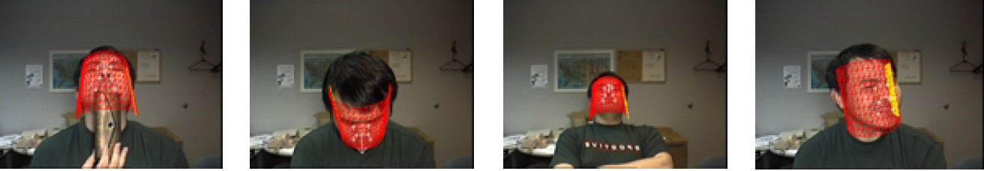
Examples
3D head tracking
xk:3D head position and orientation
zk: color images of head region
[Jing et al , 2003]

Slide 22
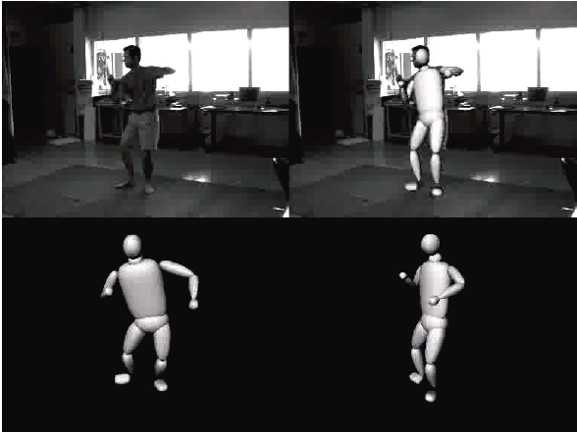

Examples
3D skeletal pose tracking
xk: 3D skeletal poses
zk: image measurements including silhouettes, edges, colors, etc.

Slide 23
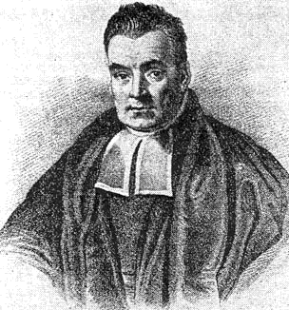
Bayesian Tracking
Construct the posterior probability
density function of the state based on all available information
By knowing the posterior many kinds of estimates for can be derived
  mean (expectation), mode, median, …
  Can also give estimation of the accuracy (e.g. covariance)
Thomas Bayes
Posterior
Sample space
Notes:
Posterior density sometimes referred to as the “filtered density” ( as opposed to p(x_{0:k}|z_{1:k}) )

Slide 24
Bayesian Tracking
State posterior
Mean state

Slide 25
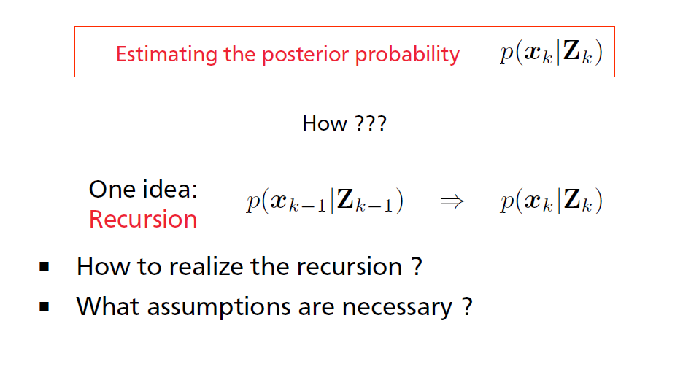
Bayesian Tracking
Goal: estimate the most likely state given the observed measurements up to the current frame

Slide 26
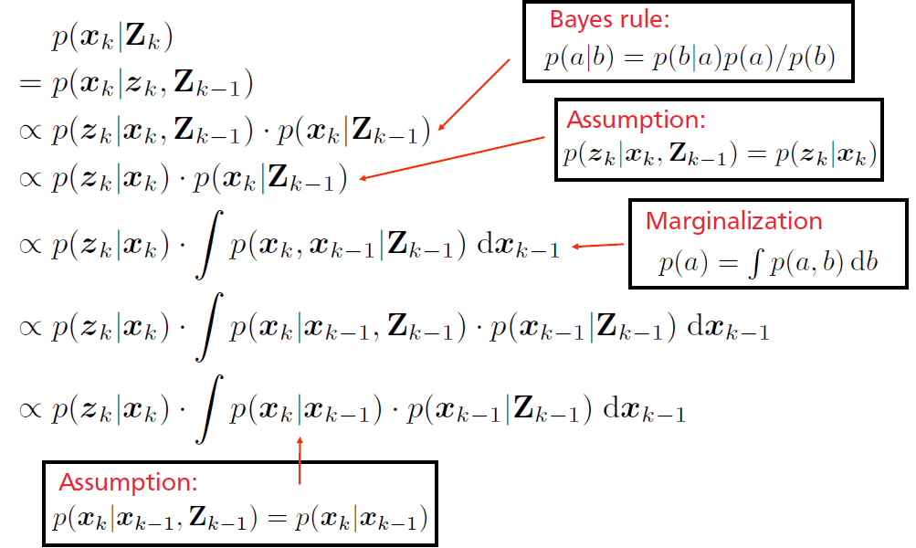
Recursive Bayesian Estimation

Slide 27
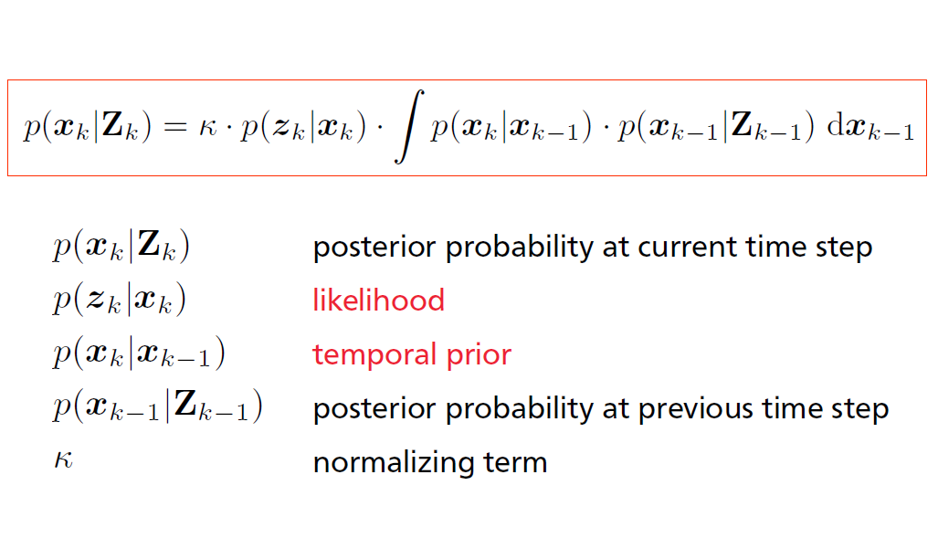
Bayesian Formulation

Slide 28
Bayesian Tracking

Slide 29

Bayesian Tracking
Hidden state
x1
……
xk-2
xk-1
xk
Observed measurements
z1
……
zk-2
zk-1
zk

Slide 30
Bayesian Tracking
Hidden state
x1
……
xk-2
xk-1
xk
Observed measurements
z1
……
zk-2
zk-1
zk

Slide 31

Bayesian Tracking

Slide 32

Bayesian Tracking
Hidden state
x1
……
xk-2
xk-1
xk
Observed measurements
z1
……
zk-2
zk-1
zk

Slide 33

Bayesian Tracking:
Temporal Priors
The PDF models the prior knowledge that predicts the current hidden state using previous states
- simple smoothness prior, e.g.,
- linear models, e.g.,
- more complicated prior models can be constructed via data-driven modeling techniques or physics-based modeling techniques

Slide 34

Bayesian Tracking: Likelihood
Hidden state
x1
……
xk-2
xk-1
xk
Observed measurements
z1
……
zk-2
zk-1
zk

Slide 35
Bayesian Tracking: Likelihood
The likelihood term measures how well the hidden state matches the observed measurements

Slide 36
Bayesian Tracking: Likelihood
The likelihood term measures how well the hidden state matches the observed measurements
- In general, we can define the likelihood using analysis-by-synthesis strategy.
- We often assume residuals are normal distributed.

Slide 37
Bayesian Tracking: Likelihood
The likelihood term measures how well the hidden state matches the observed measurements
xk:2D location and scale
zk: color histograms
How to define the likelihood term for 2D region tracking?

Slide 38
Bayesian Tracking: Likelihood
The likelihood term measures how well the hidden state matches the observed measurements
xk:2D location and scale
zk: color histograms
Matching residuals

Slide 39
Bayesian Tracking: Likelihood
The likelihood term measures how well the hidden state matches the observed measurements
xk:2D location and scale
zk: color histograms
Matching residuals
Equivalent to

Slide 40
Bayesian Tracking: Likelihood
The likelihood term measures how well the hidden state matches the observed measurements
xk:3D head position and orientation
zk: color images of head region
Synthesized image

Slide 41
Bayesian Tracking: Likelihood
The likelihood term measures how well the hidden state matches the observed measurements
xk:3D head position and orientation
zk: color images of head region
observed image

Slide 42
Bayesian Tracking: Likelihood
The likelihood term measures how well the hidden state matches the observed measurements
xk:3D head position and orientation
zk: color images of head region
Matching residuals

Slide 43
Bayesian Tracking
How to estimate the following posterior?

Slide 44
Bayesian Tracking
How to estimate the following posterior?
The posterior distribution p(x|z) may be difficult or impossible to compute in closed form.

Slide 45
Bayesian Tracking
How to estimate the following posterior?
The posterior distribution p(x|z) may be difficult or impossible to compute in closed form.
An alternative is to represent p(x|z) using Monte Carlo samples (particles):
  Each particle has a value and a weight
x
x

Slide 46
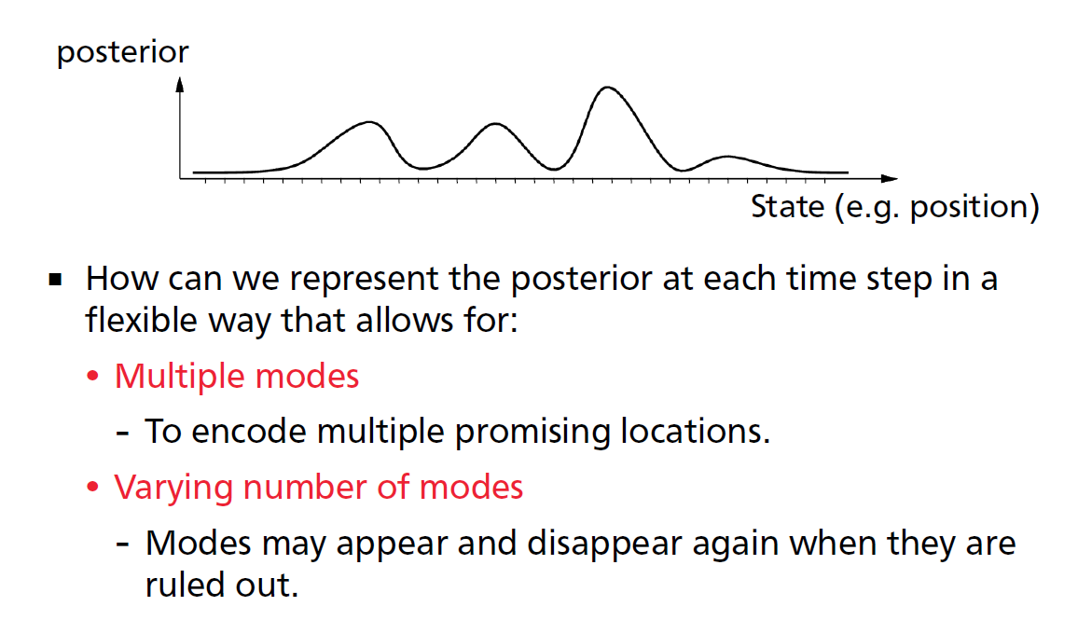
Multiple Modal Posteriors

Slide 47
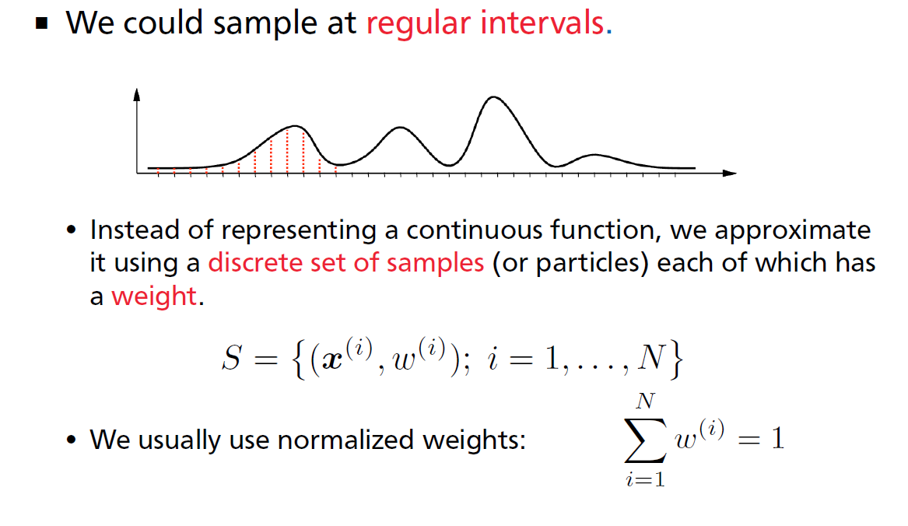
Non-Parametric Approximation

Slide 48
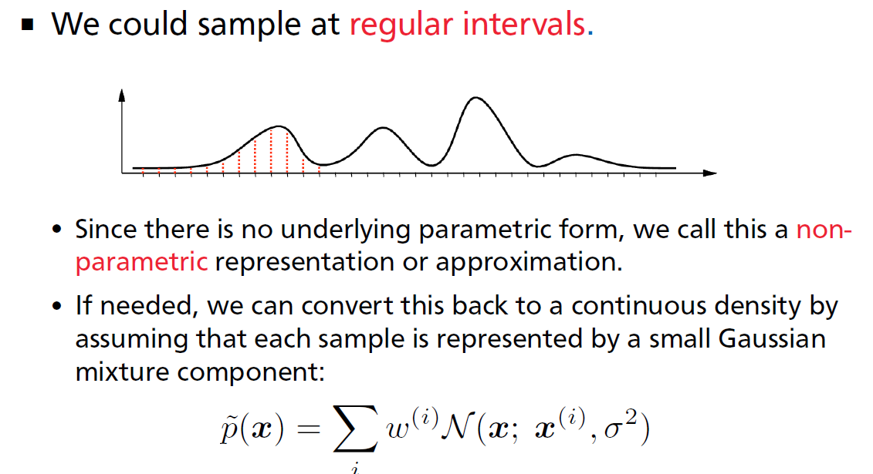
Non-Parametric Approximation
This is similar kernel-based density estimation!
However, this is normally not necessary

Slide 49
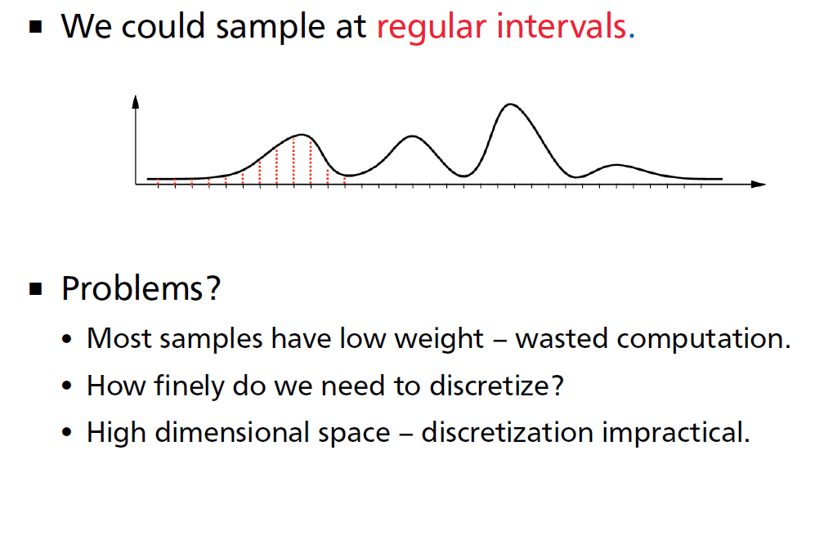
Non-Parametric Approximation

Slide 50
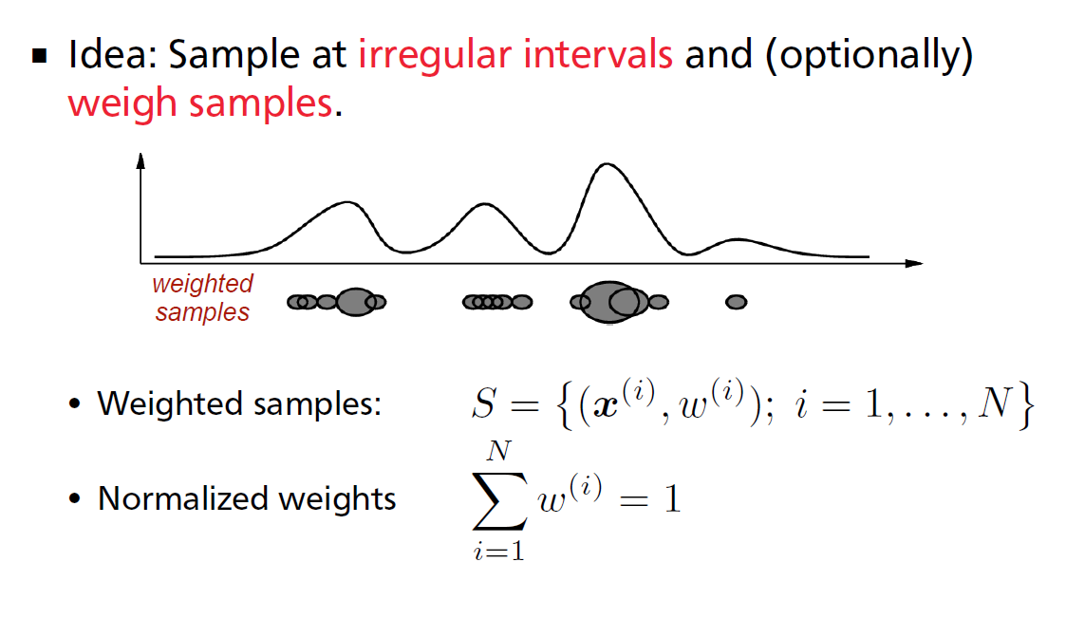
Non-Parametric Approximation

Slide 51
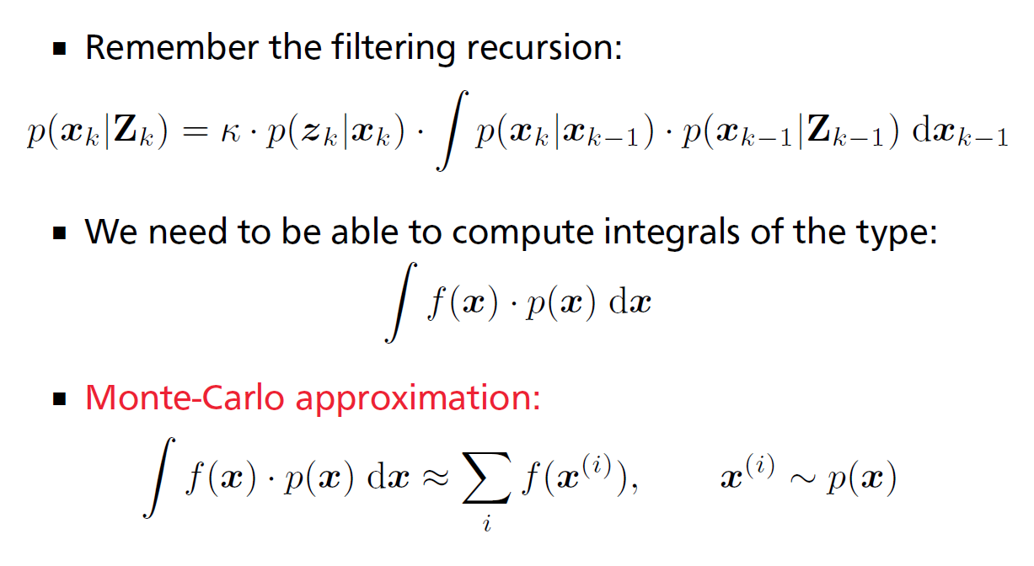
How Does This Help Us?

Slide 52
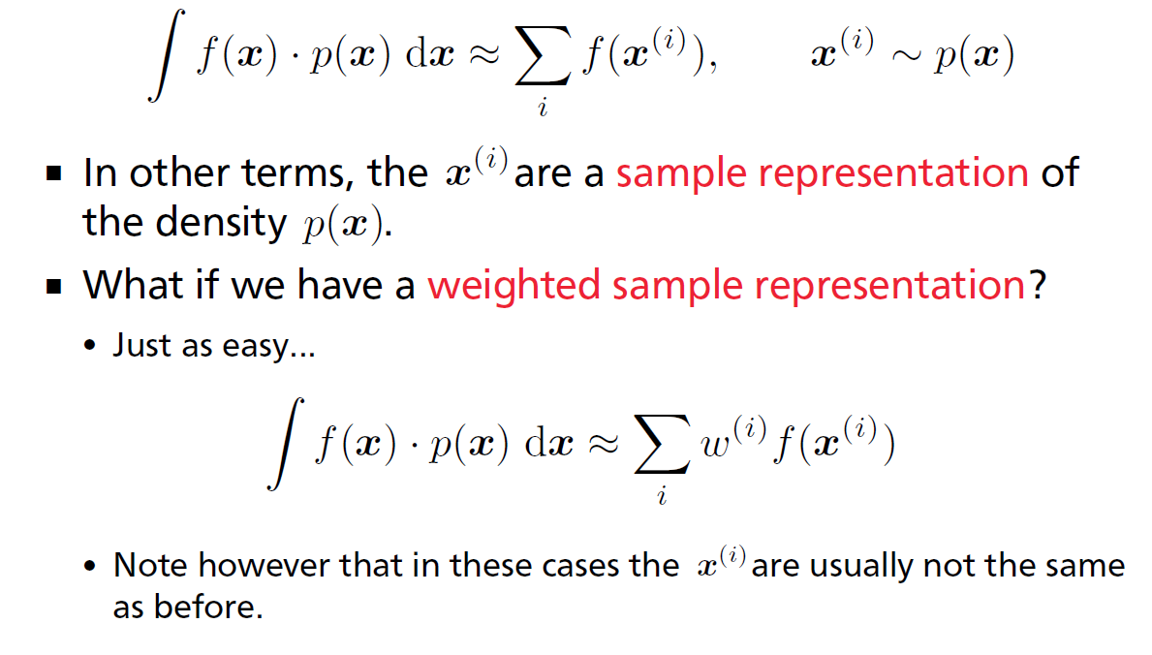
Monte Carlo Approximation

Slide 53
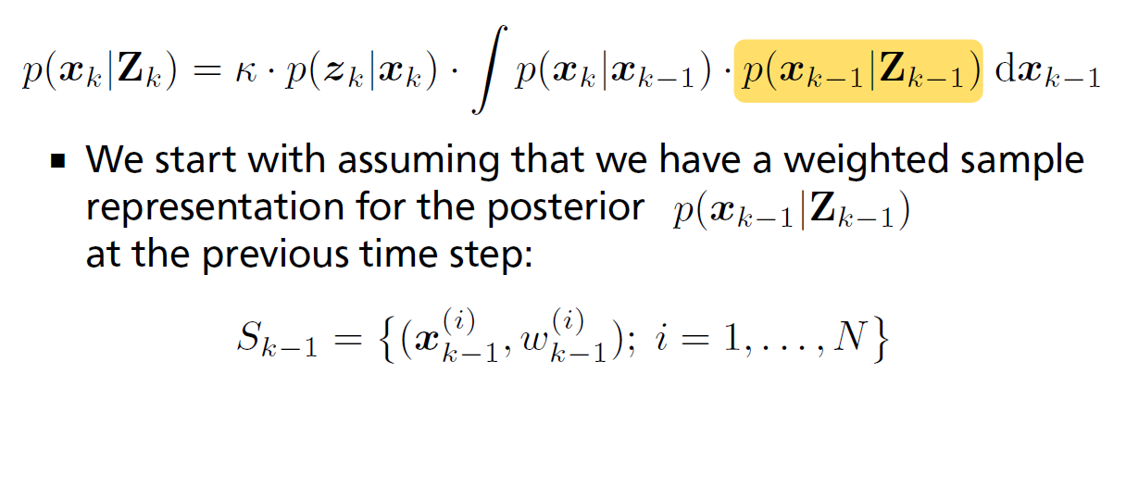
Filtering: Step-by-Step

Slide 54
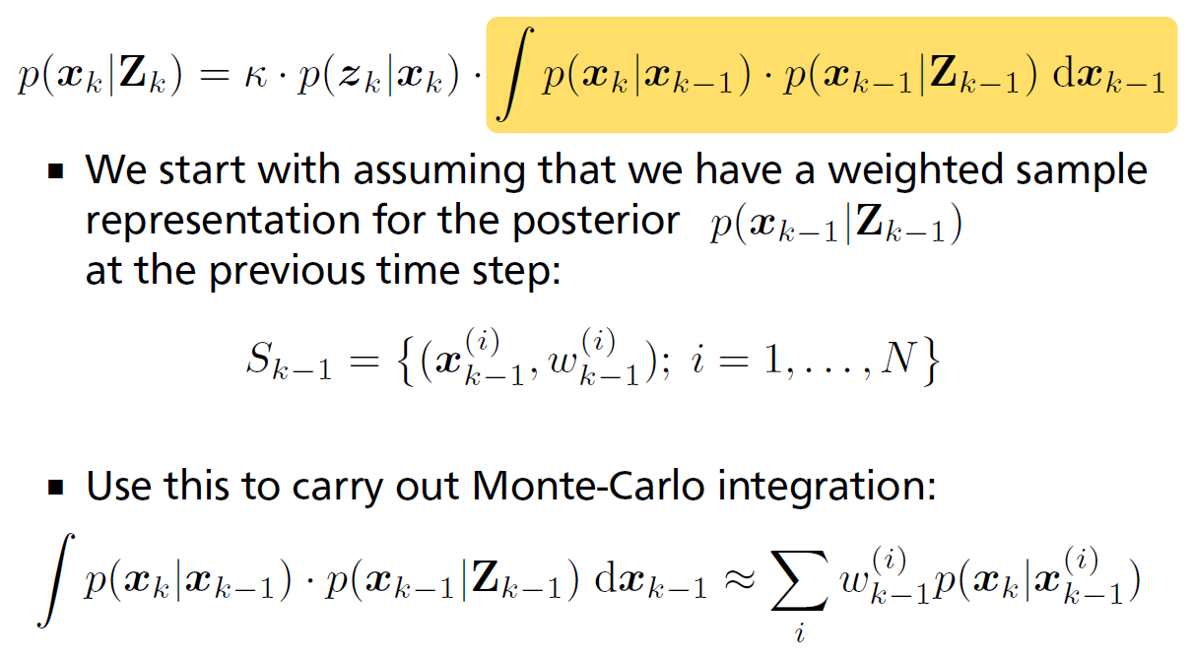
Filtering: Step-by-Step

Slide 55
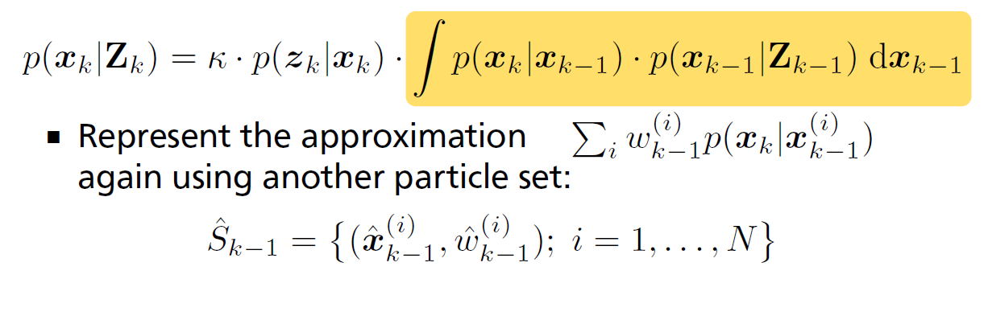
Filtering: Step-by-Step

Slide 56
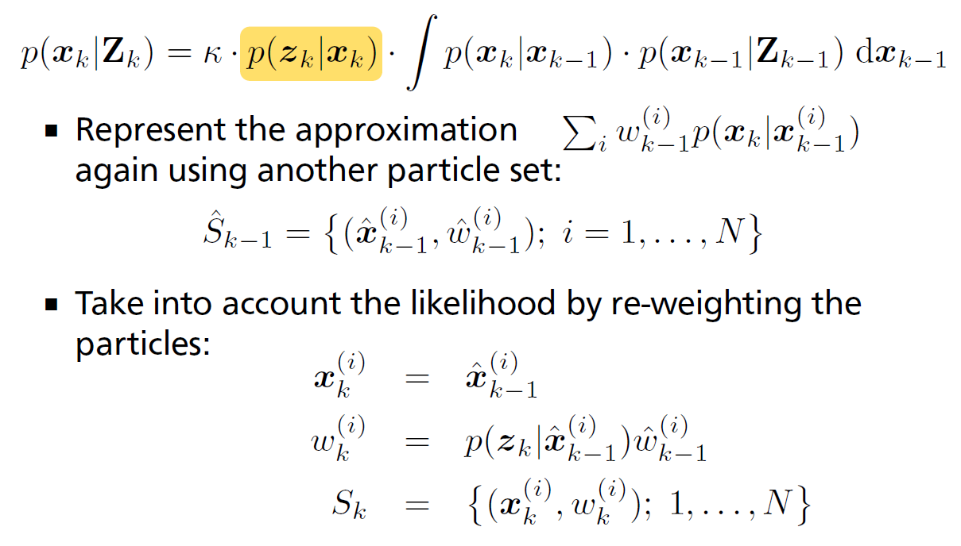
Filtering: Step-by-Step

Slide 57
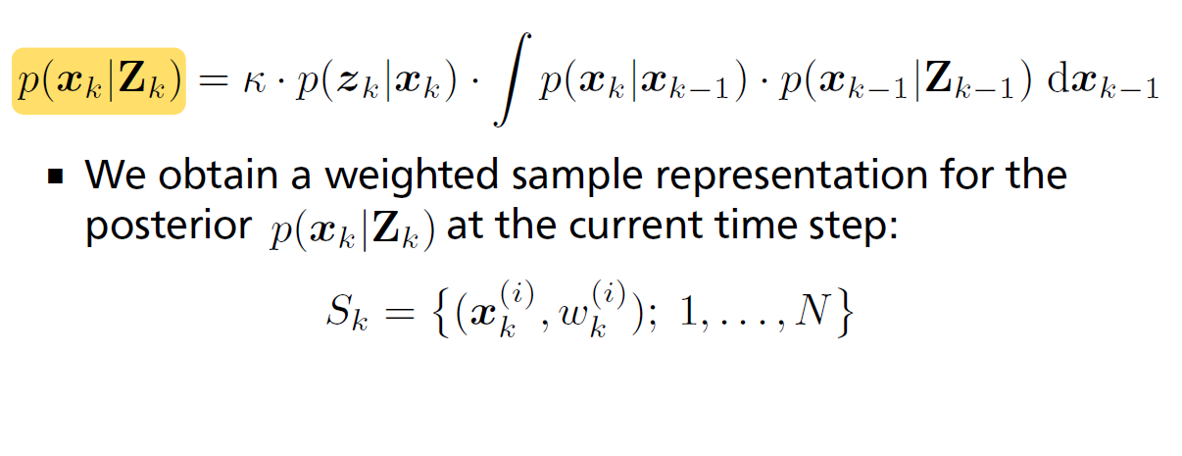
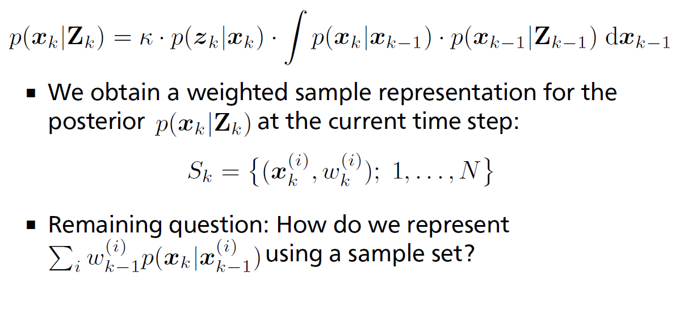
Filtering: Step-by-Step

Slide 58
Filtering: Step-by-Step

Slide 59
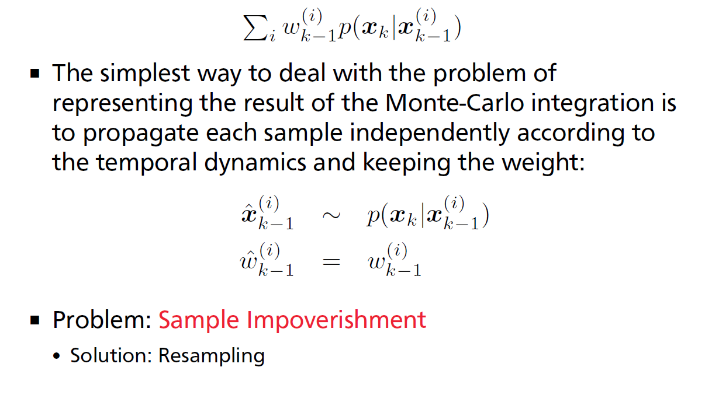
Temporal Propagation

Slide 60
Temporal Propagation
after a few iterations, most particles have negligible weight (the weight is concentrated on a few particles only)!

Slide 61
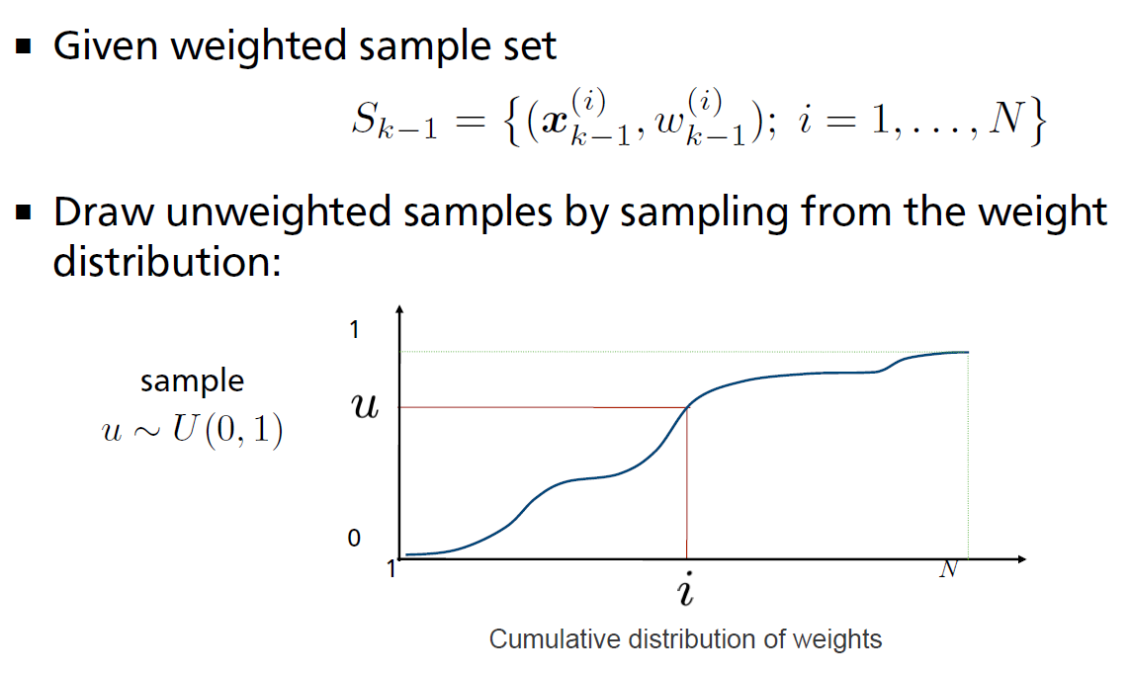
Resampling

Slide 62
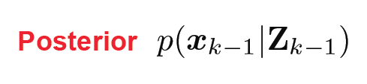
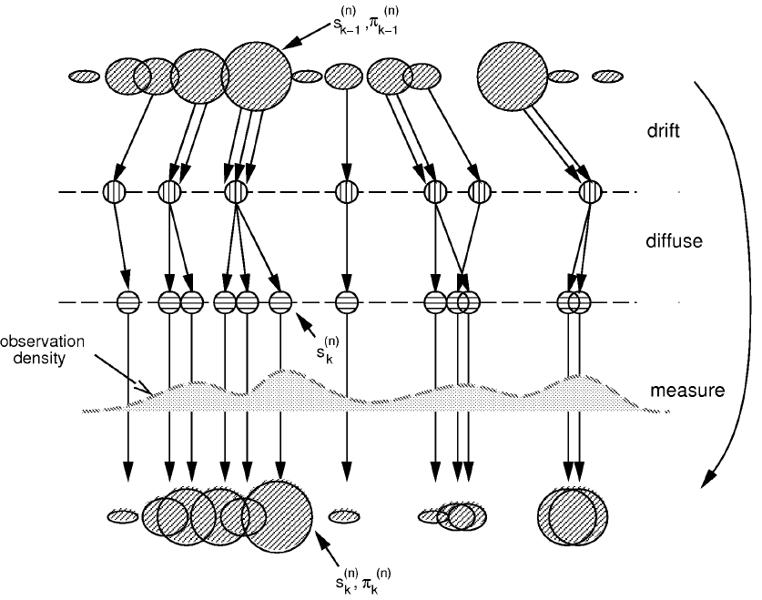
Particle Filtering
Isard & Blake IJCV 98

Slide 63

Particle Filtering
Isard & Blake IJCV 98

Slide 64
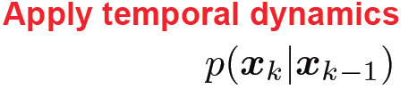
Particle Filtering
Isard & Blake IJCV 98

Slide 65
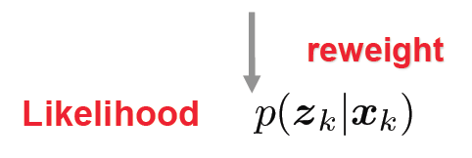
Particle Filtering
Isard & Blake IJCV 98

Slide 66
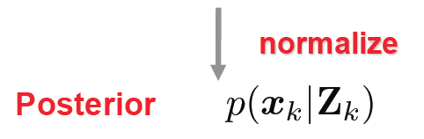
Particle Filtering
Isard & Blake IJCV 98

Slide 67
Particle Filtering in Action
Video (click here)

Slide 68
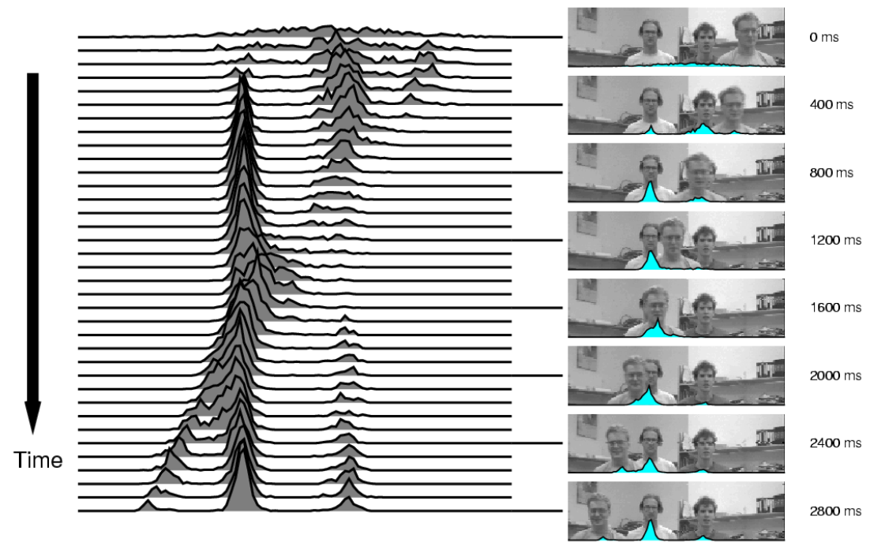
State Posterior
Isard & Blake IJCV 98

Slide 69
Leaf Examples
Video (click here)

Slide 70
Dancing Examples
Video (click here)

Slide 71
Hand Examples
Video (click here)

Slide 72
Some Properties
It can be shown that in the infinite particle limit this converges to the correct solution [Isard & Blake].
In practice, we of course want to use a finite number.
- In low-dimensional spaces we might only need 100s of particles for the procedure to work well.
- In high-dimensional spaces sometimes 1000s, 10000s or even more particles are needed.
There are many variants of this basic procedure, some of which are more efficient (e.g. need fewer particles)
- See e.g.: Arnaud Doucet, Simon Godsill, Christophe Andrieu: On sequential Monte Carlo sampling methods for Bayesian filtering. Statistics and Computing, vol. 10, pp. 197-- 208, 2000.

Slide 73
Summary: Particle Filtering
Advantages
+ can deal with nonlinearities and non-Gaussian noise
+ use temporal priors for tracking
+ Multi-modal posterior okay
+ Multiple samples provides multiple hypotheses
+ Easy to implement
Disadvantages
- might become computationally inefficient, particularly when tracking in a high-dimensional state space (e.g., 3D human bodies)
- but parallelizable and thus can be accelerated via GPU implementations.

