Slide 2
Sketch One Ideas

Slide 3
Sketch One Ideas

Slide 4
Team Creation
3-4 teams

Slide 5
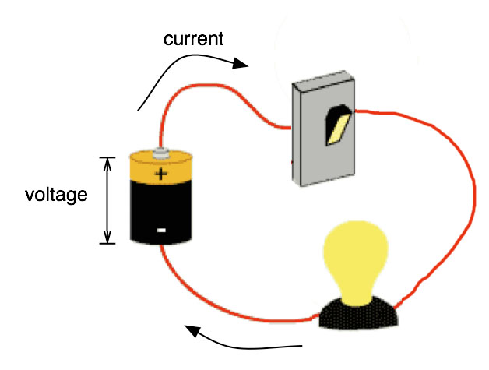
Making Circuit
Notes:
Voltage pushes, current flows

Slide 6
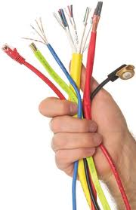
Connections

Slide 7
Connections
X

Slide 8
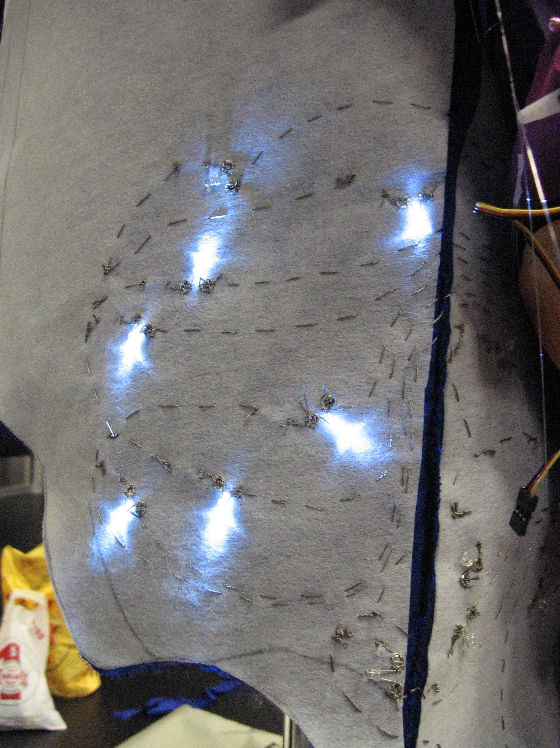
Connections for Soft Circuit
Notes:
Specialized materials
Tips for conductive threads http://www.youtube.com/watch?v=XT5ygUt8Cbk

Slide 9
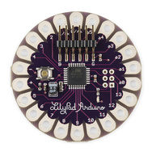
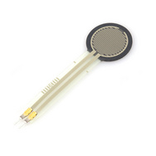
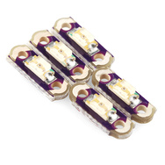
Soft Circuit Components
Microcontroller – Lilypad
INPUT - Touch Sensor
OUTPUT - LEDs

Slide 10
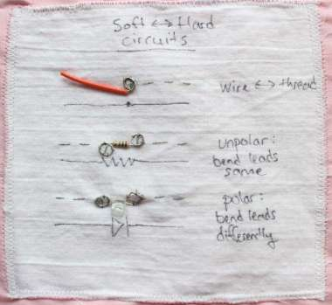
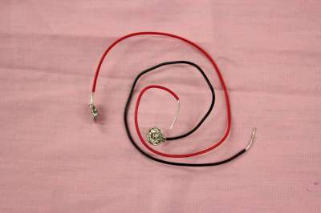
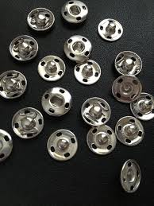
Sewing Tips
No overlaps
Bend the leads
Snaps – to connect hard/soft material

Slide 11
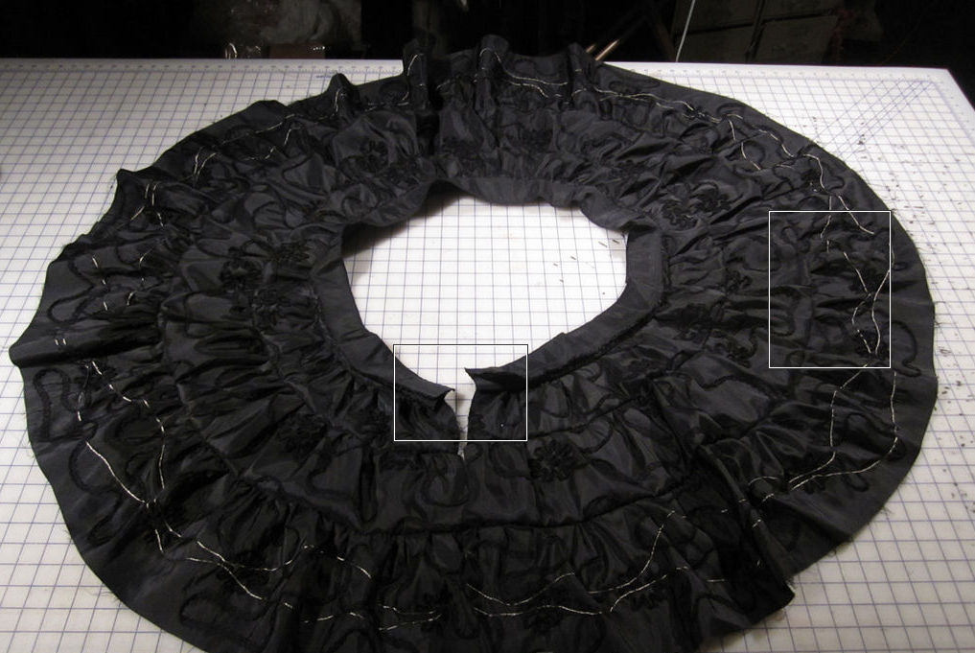
Sewing Tips
Draw your circuit on a paper first

Slide 12
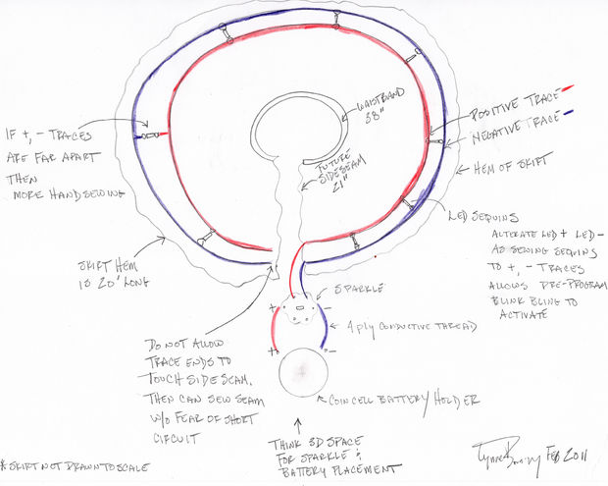
Sewing Tips
Draw your circuit on a paper first

Slide 14
Notes:
Pwm 3. 5. 6. 9, 10, 11

